Slide 1
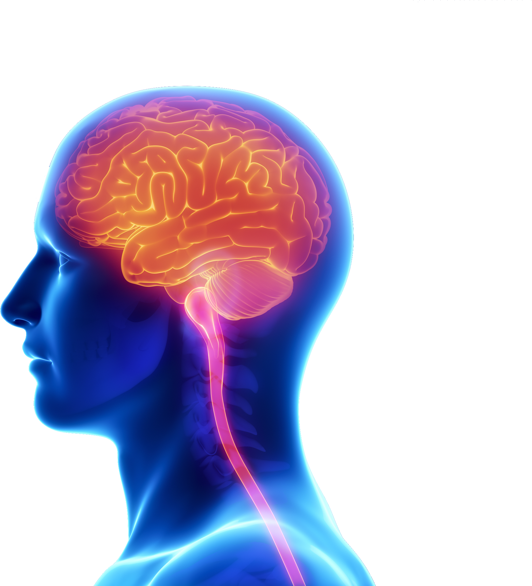

Most powerful weapon in the
world
Classification | INTERNAL

Slide 2
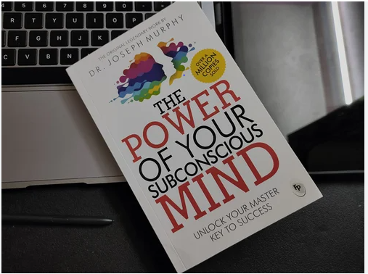
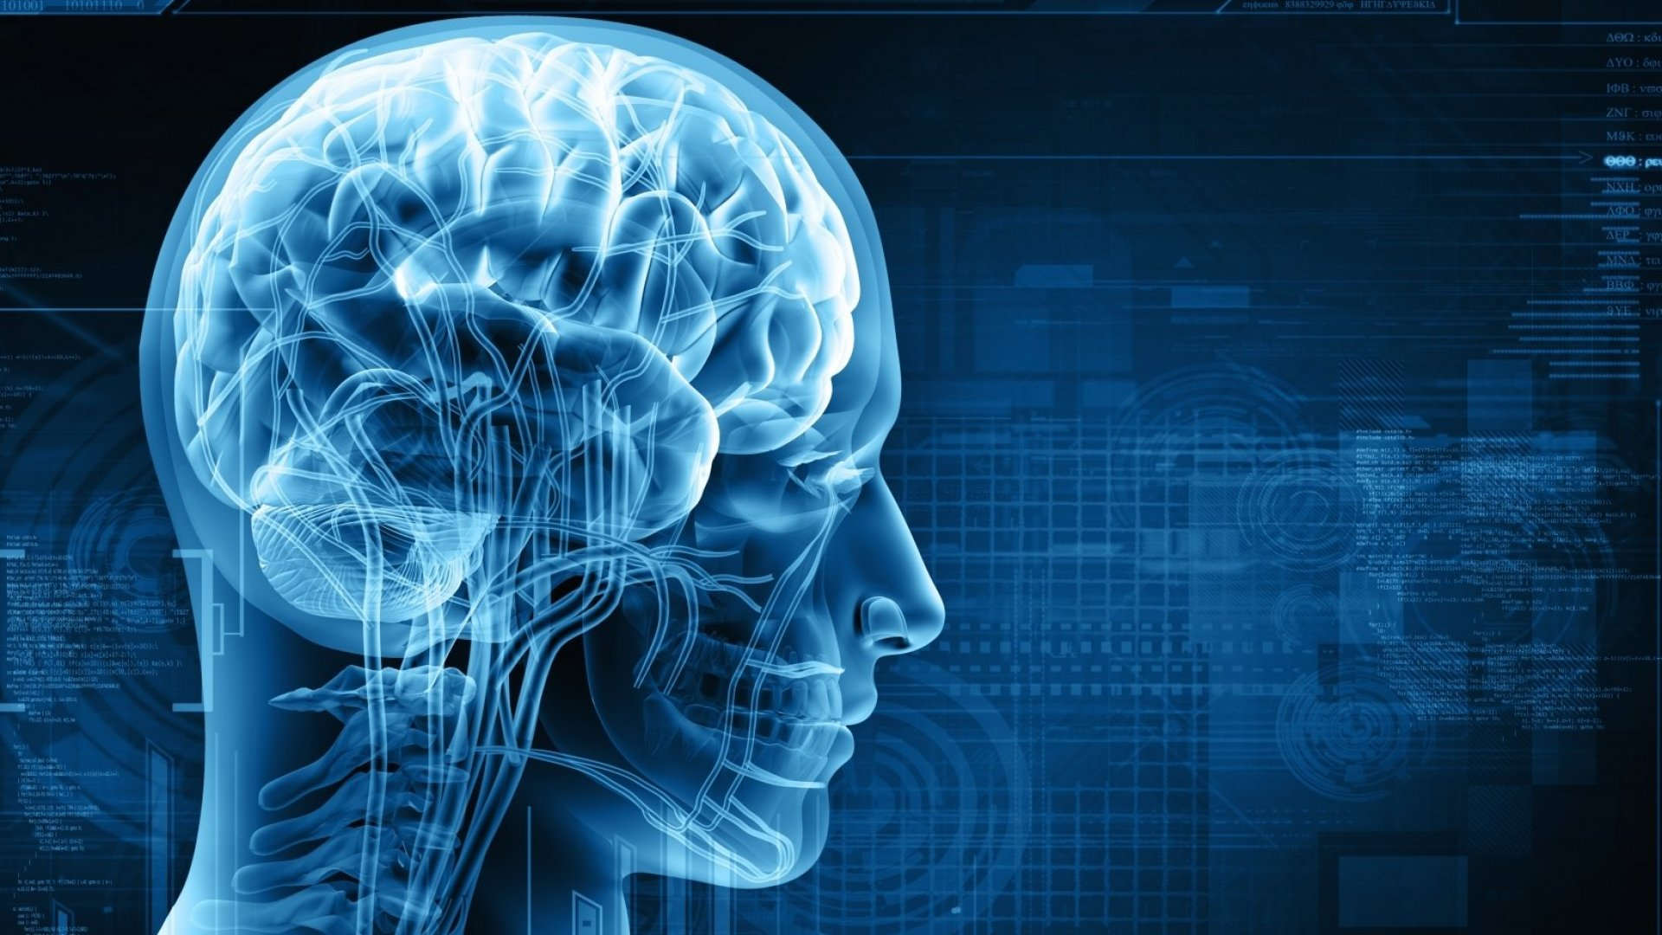
the power of subconscious mind
Dr . Joseph Murphy
California, United States
Classification | INTERNAL

Slide 3
Agenda :-
Conscious Mind Vs. Your Subconscious Mind?
How Your Subconscious Mind Operates.
How to train your Subconscious Mind .
How the Subconscious Controls All Functions of the body .
The Law of Belief .
Your Subconscious will Accept Your Blueprints
Classification | INTERNAL

Slide 4
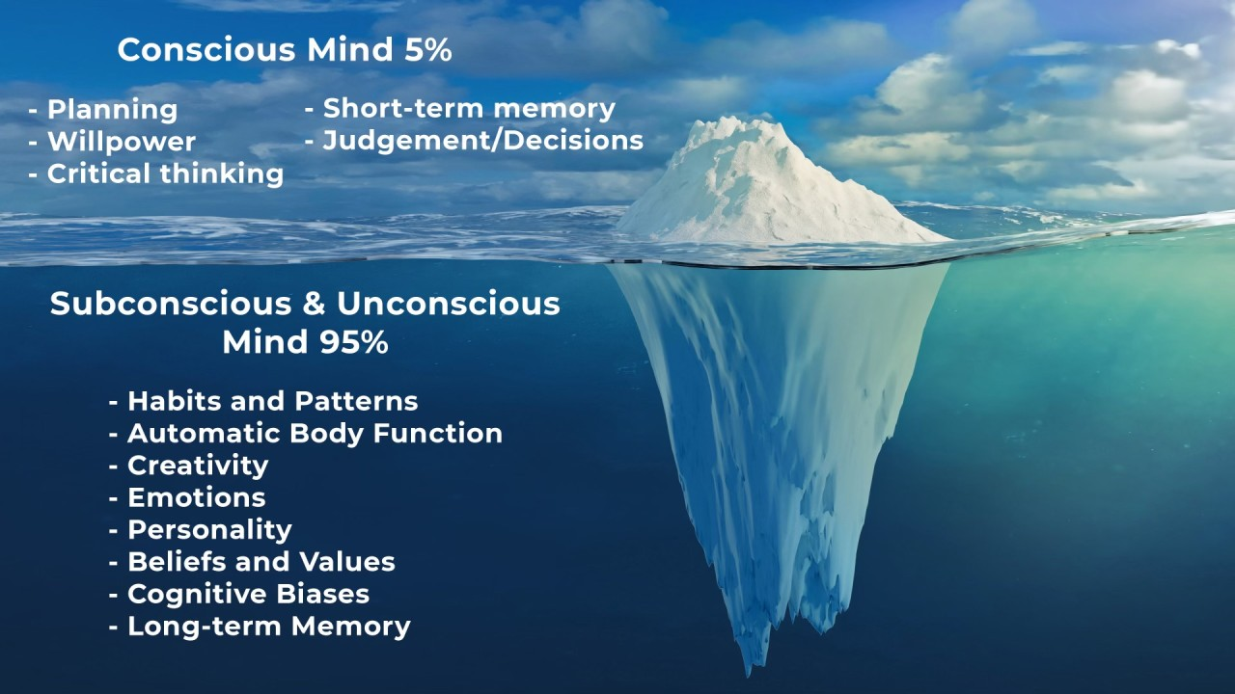
Classification | INTERNAL

Slide 5
* How Your Subconscious Mind Operates ?*
The subconscious mind goes beyond learning new skills.
It's involved in information processing and affects everything we think, say and do.
It stores our beliefs and values, determines our memories and monitors the information all around us,
deciding what to send to the conscious mind and what to store for later.
Classification | INTERNAL

Slide 6



* How to configure our Subconscious Mind ?
Positive affirmations .
Visualization .
Meditation .
Controlling your will and habits
Have a master plan for your life./
Surround yourself with allies.
Classification | INTERNAL

Slide 7

How the Subconscious Controls All Functions of the body .
Classification | INTERNAL

Slide 8

The Law of Belief .
Classification | INTERNAL

Slide 9
Your Subconscious will Accept Your Blueprints
Classification | INTERNAL

Slide 10

Classification | INTERNAL

